Slide 1



Alaska WWAMI Overview

Slide 2


Pathways to Medicine
K-12
College (4 years)
Medical School (4 years)
Residency/Fellowship (3-7 years)
Practicing Physician

Slide 3
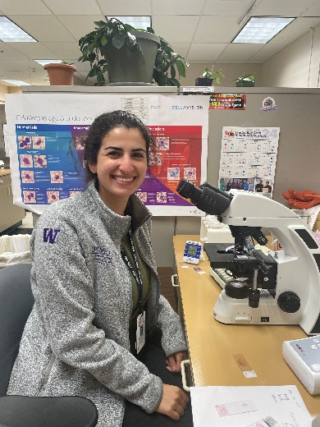

WWAMI
UW School of Medicine is the sponsoring institution for WWAMI, the five state regional medical school for Washington, Wyoming, Alaska, Montana and Idaho
WWAMI is a >50-year partnership providing high-quality, cost-effective medical education
Partner universities:
  Gonzaga University,
  University of Wyoming,
  University of Alaska Anchorage,
  Montana State University
  University of Idaho

Slide 4

Founding Goals 1971
Provide access for citizens of the Northwest to publicly supported medical education
Increase number of primary care physicians and address maldistribution of physicians
Create community-based medical education
Expand graduate medical education and continuing medical education
Avoid excessive capital costs and duplication of resources by using existing educational infrastructure
Notes:
ARE THESE MOST CURRENT ?

Slide 5

The WWAMI Curriculum
Foundations
Phase
Patient Care Phase
Explore & Focus
Year 1
Year 2
Year 3
Year 4
University of Alaska Anchorage
Clinical training region-wide
Notes:
Students complete classroom work in the Foundations phase of the curriculum at UAA
Foundations phase also includes clinical training with Alaskan physicians in Alaska
Students have the option to do many of their rotations in Alaska

Slide 6
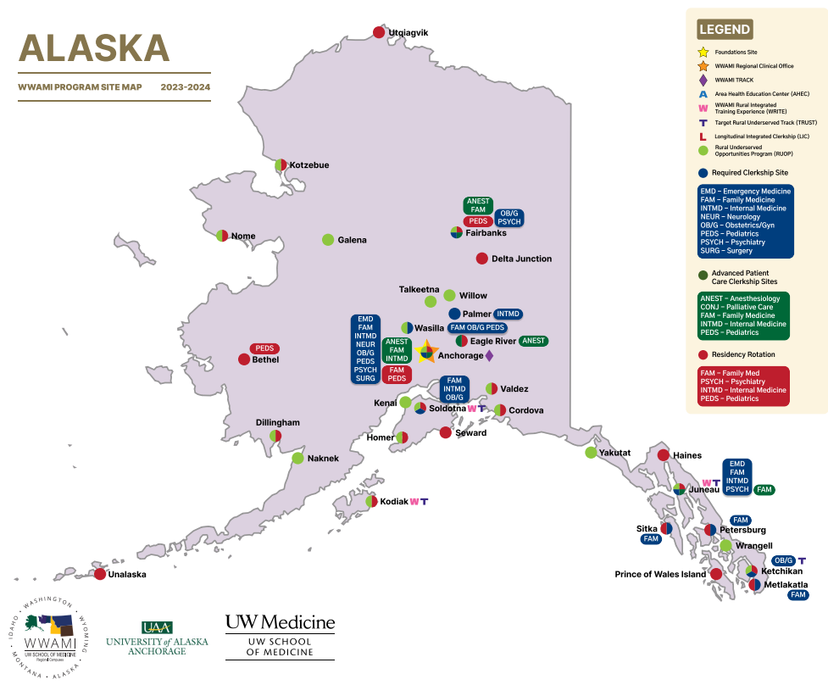

Slide 7
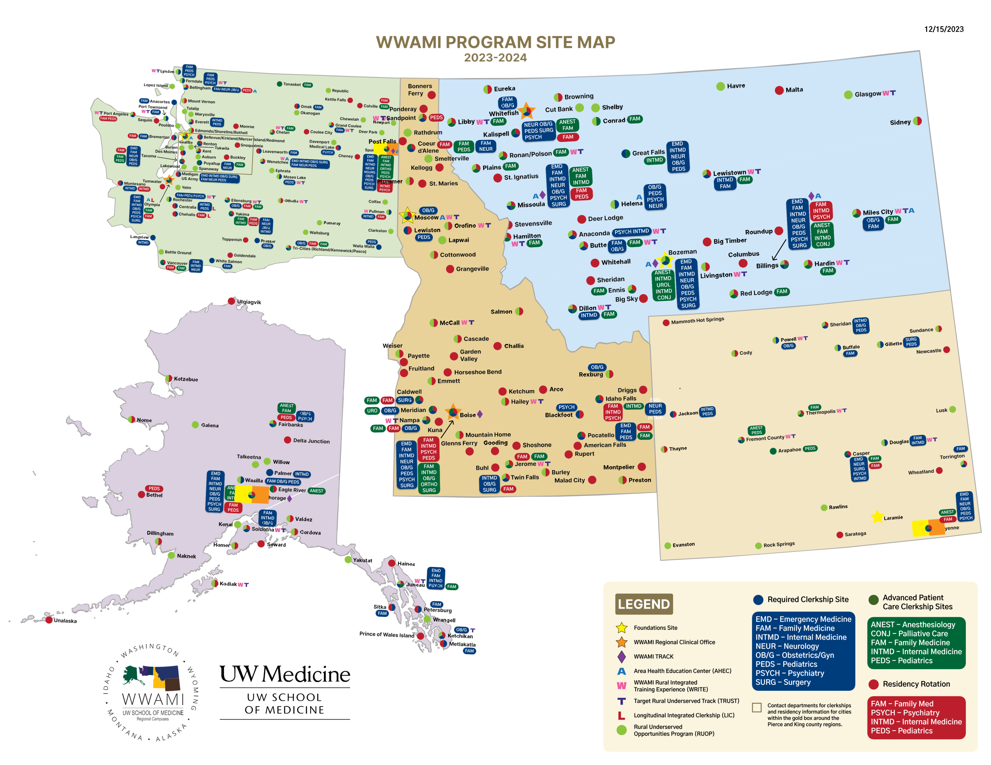

Slide 8
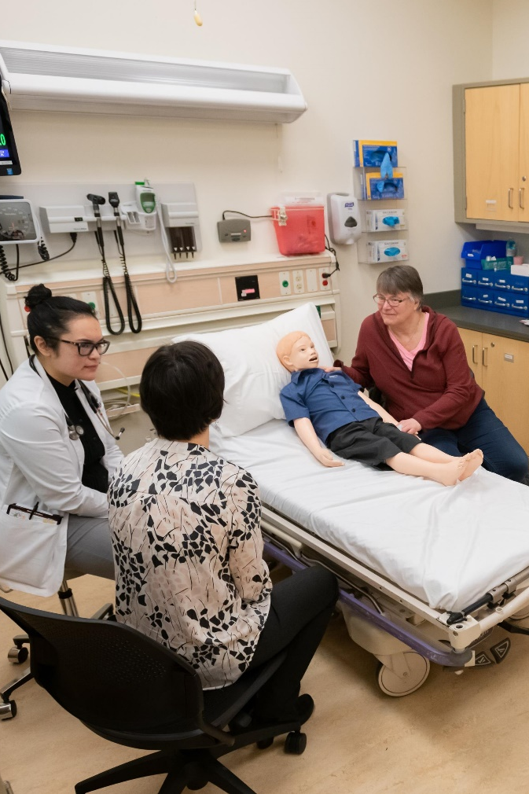
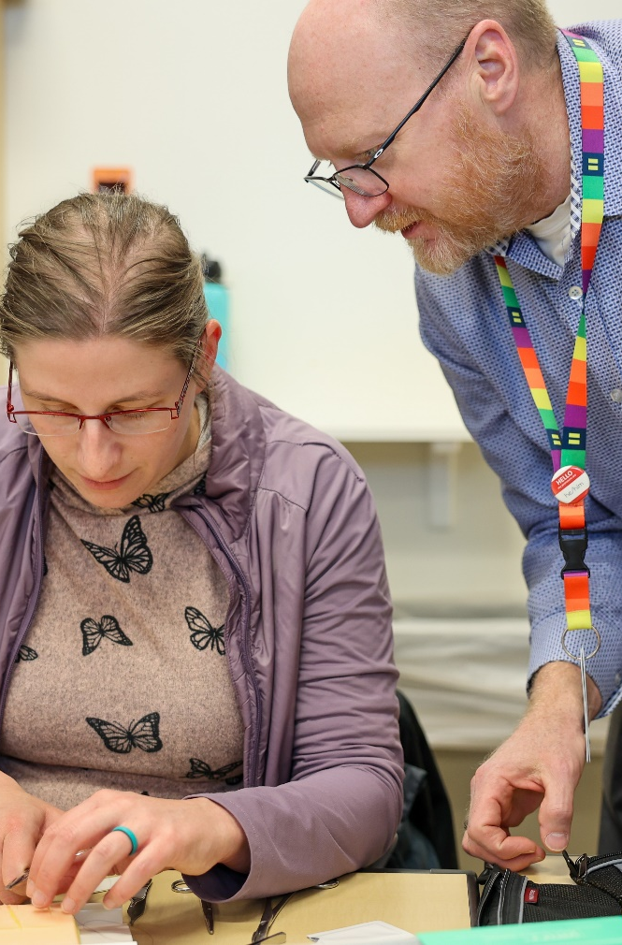
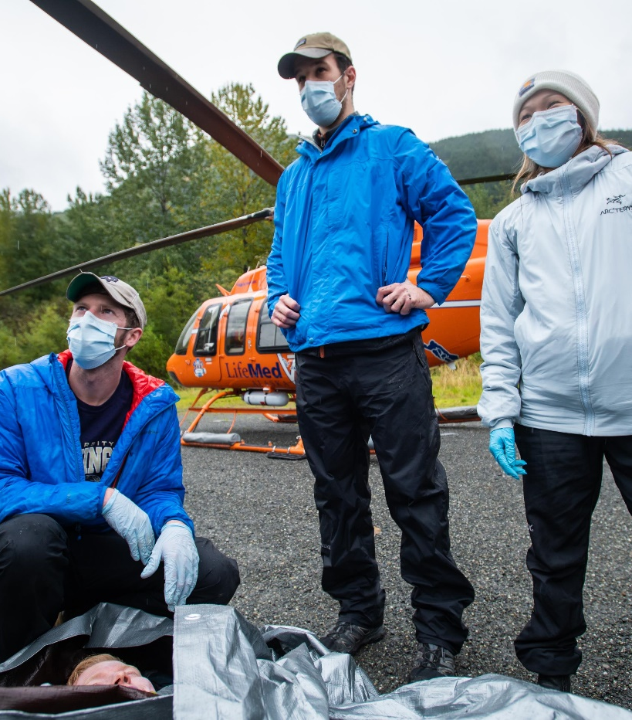
It Takes A Village ….
Notes:
UAA faculty – WWAMI specific 6 PhDs, 6 > 50% MDs and > 20 Adjunct physicians, many Affiliate faculty, and >20 Primary Care Practicum providers
Clerkships: have many more physicians and surgeons who provide clinical teaching

Slide 9
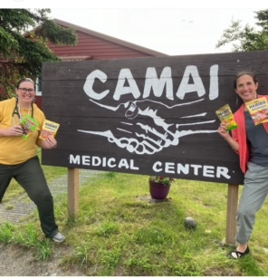
Rural Training -TRUST, RUOP, & WRITE
TRUST – early and longitudinal rural experiences and training
RUOP – summer rural clinical experience with community-based project
WRITE – 3rd year longitudinal rural clerkship
Notes:
Experienced physicians working in rural areas in Alaska provide practical experience and role modeling to students to deepen understanding of what practice in nonurban Alaska looks like.

Slide 10
TRUST – Targeted Rural Under Served Track
Admissions
Before medical school experience
RUOP
WRITE
Underserved pathway
Alaska TRUST locations:
Juneau
Ketchikan
Kodiak
Soldotna

Slide 11
RUOP – Rural Underserved
Opportunities Program
Alaska RUOP locations:
Anchorage
Cordova
Dillingham
Fairbanks
Galena
Homer
Juneau
Kenai
Ketchikan
Kodiak
Kotzebue
Naknak
Nome
Soldotna
Talkeetna
Valdez
Wasilla
Willow
Wrangell
Yakutak
One-month clinical experience between years 1 and 2
Community oriented project
Off-road, tribal
Notes:
Experienced physicians working in rural areas in Alaska provide practical experience and role modeling to students to deepen understanding of what practice in nonurban Alaska looks like.

Slide 12
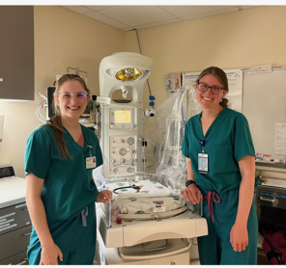
WRITE – WWAMI Rural Integrated Training Experience
3rd year required clerkships
20+ weeks longitudinal training
Alaska WRITE locations:
Juneau
Ketchikan
Kodiak
Soldotna

Slide 13
Clerkships
Required and elective
62 clerkship sites; 214 medical student rotations
Over 300 clinical faculty
Adding clerkships in family medicine, emergency medicine, internal medicine, obstetrics and gynecology, neurosurgery, palliative care
Notes:
Family Medicine – ANMC and Sitka
Emergency medicine - Anchorage
OB in Soldotna and Wasilla
Neurosurgery - Anchorage
Internal Medicine in Fairbanks
Palliative care – Anchorage

Slide 14
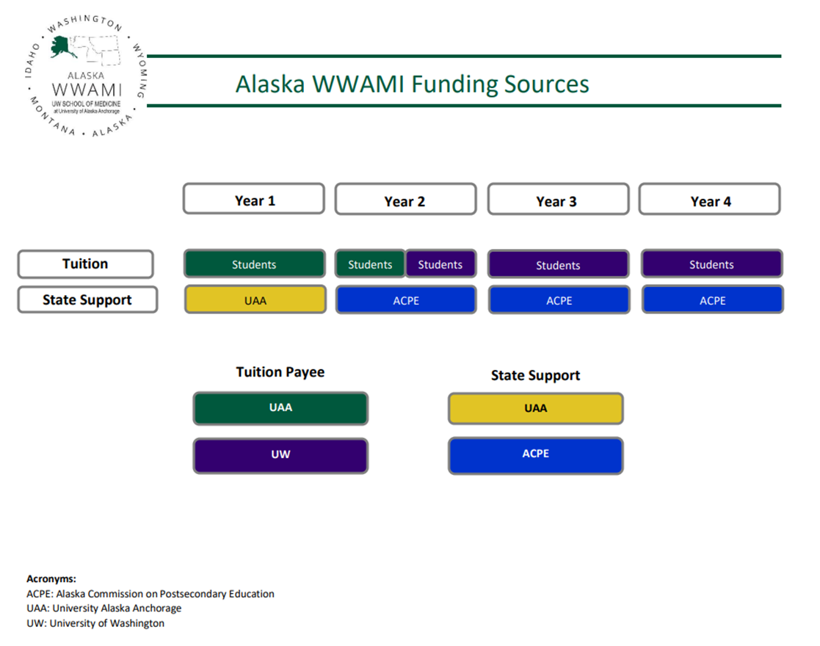
Alaska WWAMI is publicly supported medical education for Alaskans
Notes:
Students pay tuition through all 4 years
At UAA – they pay tuition to UAA
During the later half of 2nd year through 4th year – they pay tuition to UWSOM
At UAA a small amount of general fund support is received through UAA
ACPE supports students in their 2nd – 4th years of medical school

Slide 15
Alaska WWAMI Expansion
1971 to 2007 – 10 students per class
2007 to 2022 - 20 students per class
2022 to 2024 – 25 students per class
Beginning 2025 –30 students per class

Slide 16

Alaska WWAMI Success
Graduation rate >95%
The majority of Alaska WWAMI graduates return to practice in Alaska (~60%)

Slide 17
Thank you!

